Slide 1
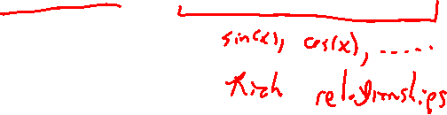
Section 7.2 Trigonometric Integrals
Lecture 1
Motivation and Trigonometry Refresh

Slide 2
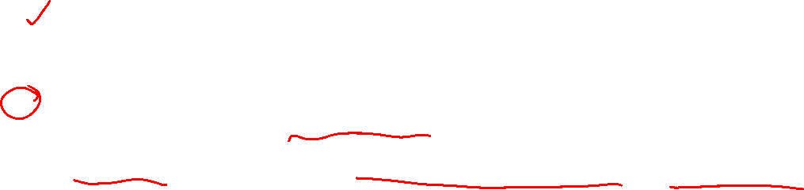
Section 7.2 Homework Submission to Canvas
Preview of section
Skim the section in text and write a short paragraph summary.
Give a bulleted list of all important definitions, theorems, and formulas without details.
Notes on video lectures
Take notes on everything written on slides including all details, worked examples, on-own activities, as well as your own thoughts and questions.
Try on-own activities first, then write down provided solution next to it for comparison.
Worked examples from the text
Write down the problem and attempt without looking at the solution.
Use the solution to write the best explanation you can.
Solutions to textbook exercises
Model approaches and explanations given in the video lectures and textbook examples.
Final reflection of section
List the key takeaways to remember as a bulleted list.

Slide 3
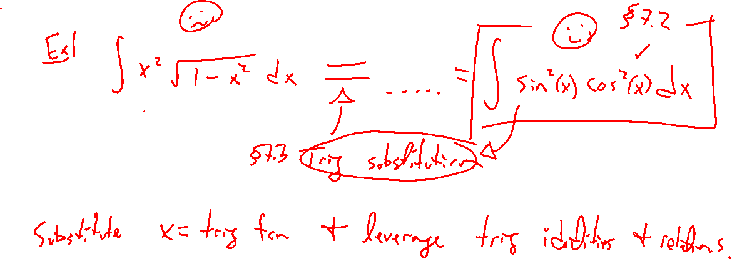
Section Motivation:
Notes:
In the next section, we will see a new type of stubstitution which tansforms.
\int x^2 \sqrt{1-x^2} dx = \int \sin^2(x) \cos^2(x) ~dx
Advantage: Open the door to leverage all trig relationships (identities)
Trig integral techniques: Everything is either u-substitution or trig identities
First, quick trig refresh

Slide 4
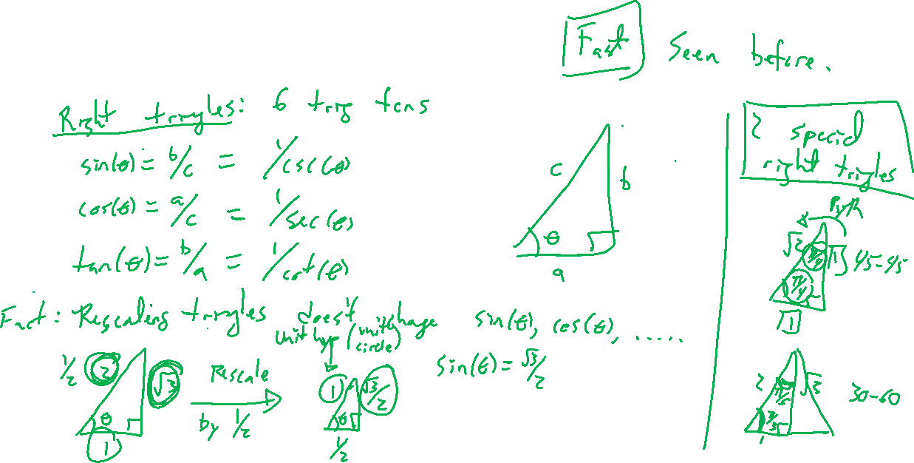
Trigonometry Refresh: Basics
Notes:
Right triangles, 6 trig functions, main 2, main 4
Rescaling and similar triangles, sine / cosine do not change
Special right triangles

Slide 5
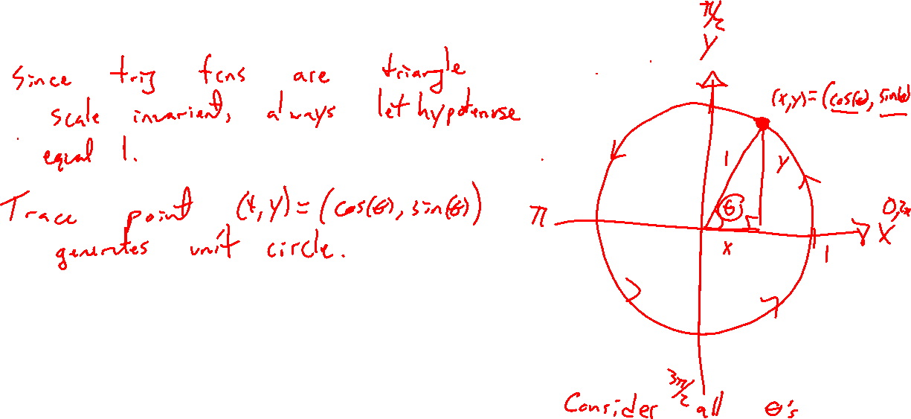
Trigonometry Refresh: Unit Circle
Notes:
Rescale to unit hypothesis
Generalize triangle to unit circle, special right triangles generalize to any angle
(x,y) = (\cos(\theta), \sin(\theta))

Slide 6
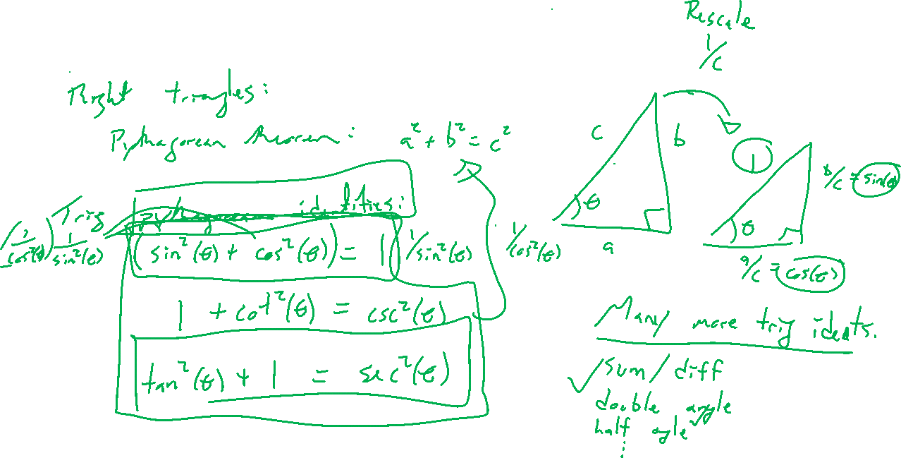
Trigonometry Refresh: Identities
Notes:
Triangle pythagoras
Trig pythagoras (know these)
Double angle / half angle (know these)
Much more, symmetry, sum/diff, prod to sum, sum to prod

Slide 7
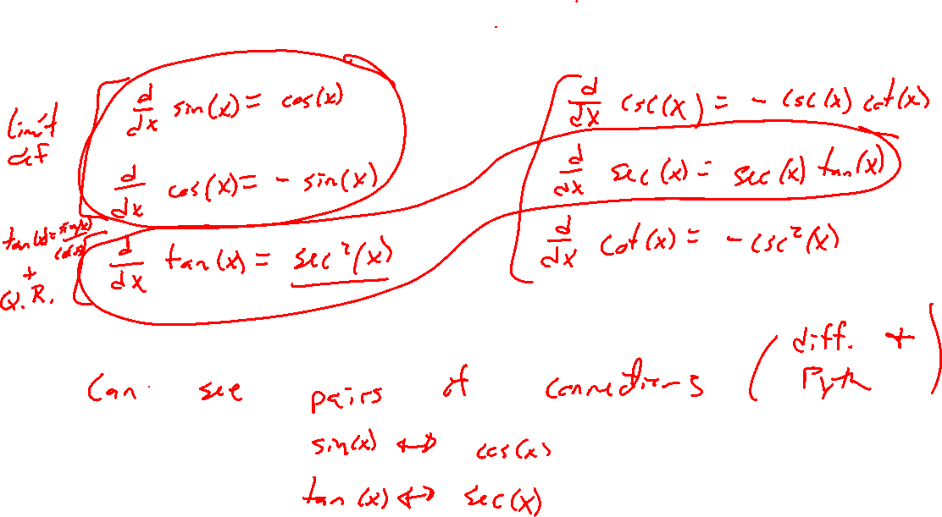
Trigonometry Refresh: Derivatives
Notes:
Six main trig
Combining with Pythagorean ids, see why sin/cos and tan/sec are buddies

Slide 8
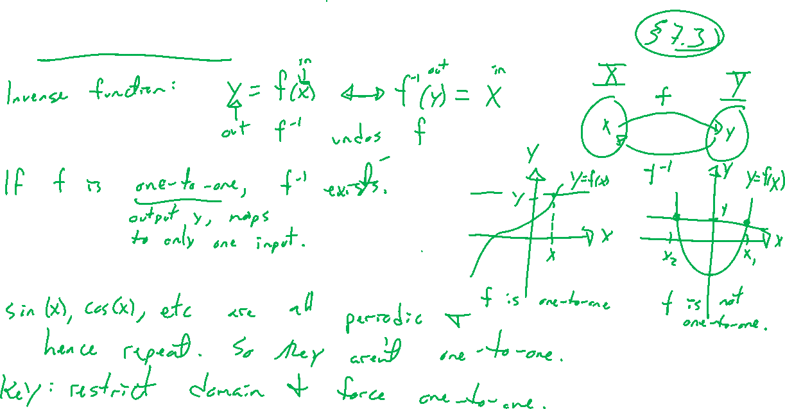
Trigonometry Refresh: Inverses (Bonus)
Notes:
Don't sweat details, know it exists
Inverse idea
Sine and tagnent only

Slide 9
Trigonometry Refresh: Desmos
Notes:
Sine / cosine unit circle
Inverse function

